Slide 1
Household Electricity

Slide 2
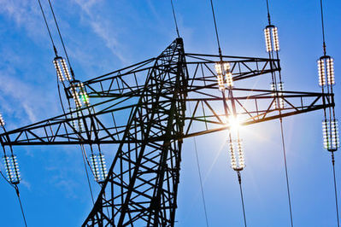
The electricity produced by batteries and solar cells is in the form of Direct Current (DC), which means it flows in the same direction all the time.
However, the electricity delivered to your house through power lines is in a different form. It is called Alternating Current (AC), because the direction of current changes (alternates) at a certain rate.
In Australia, the current in power lines alternates 50 times in each second. We say it has a frequency of 50 Hertz, or 50 Hz. There is also an associated voltage, which cycles at the same rate. The electricity supplied to your house has an "average" voltage of 240 V.

Slide 3
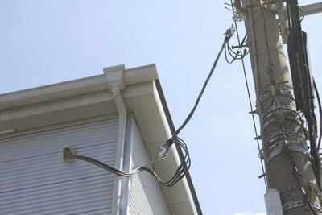
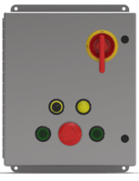
A cable connects your home to the power lines. Inside this cable are two wires coated with insulating material. One of them is called the active wire, while the other is the neutral wire. Both wires are directed to a switchboard, also called a fuse box, which divides and distributes the incoming AC.
The active wire is the one that actually delivers power to your house. From the switchboard, it passes through an energy meter, which is how a power company measures your energy usage. Then it goes on to energise the various circuits that operate your appliances and devices.
The purpose of the neutral wire is to complete the circuit and let AC flow safely back out of your home. It is connected to the ground (earthed) and has almost the same electric potential as the ground. This is a safety precaution, designed to help prevent shocks.

Slide 4
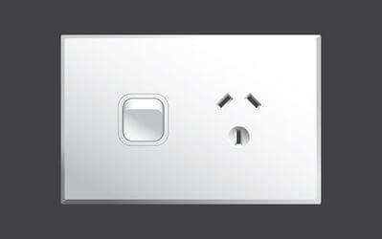
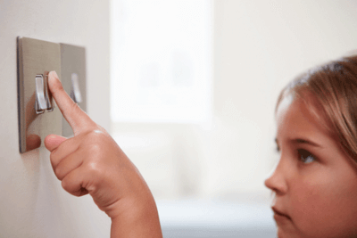
Now we get to the part you're more familiar with - places where power is actually used.
Power points like this one are all connected by a big circuit, which is energised by the active wire. You don't see any of the circuit itself, because it's mostly inside the ceiling.
There is a separate circuit that powers all the lights, and another one for large appliances like your fridge.

Slide 5
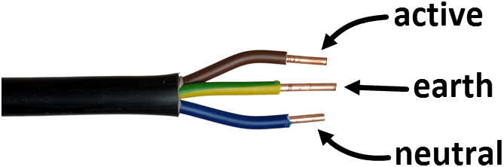
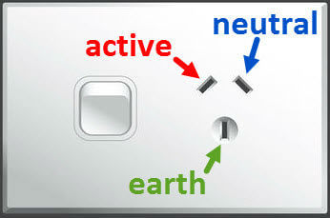
Most appliances connect to power points with a three-pin plug. Inside the plug are three wires as shown in the diagram below. They are the active, neutral and earth wires.
The earth wire is connected to the metallic frame of the appliance in question. If the appliance develops a fault, this wire acts as a safety mechanism and turns off the active circuit, preventing an electric shock.
The pins on the plug each have one of these wires attached to them. They are arranged so they match with the corresponding socket in a power point. This diagram shows the connections to the active/neutral wires and earth.

Slide 6
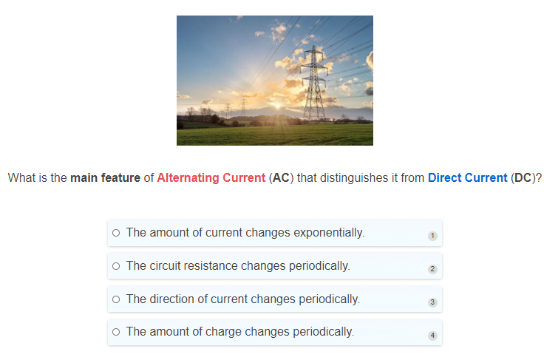

Slide 7
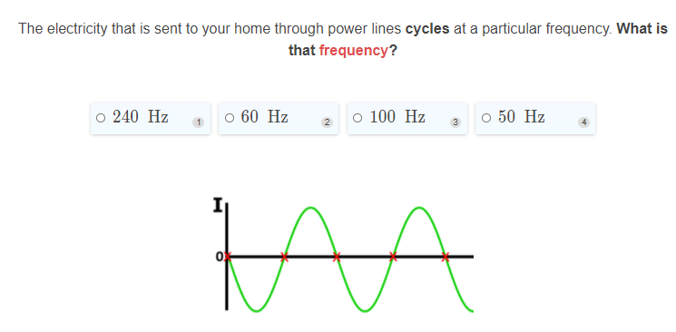

Slide 8
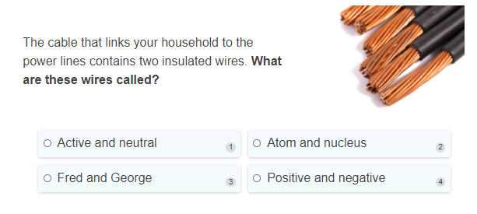

Slide 9
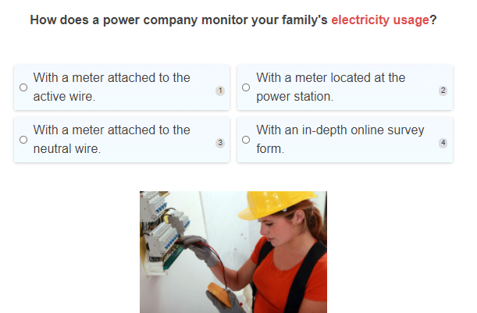

Slide 10
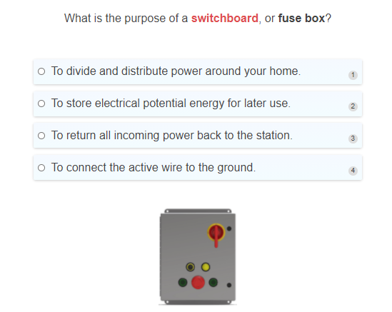

Slide 11
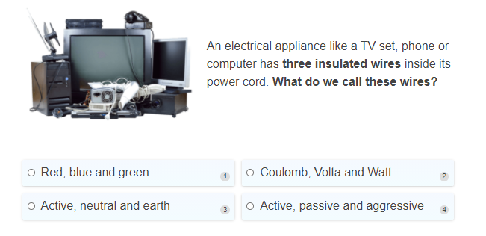

Slide 12
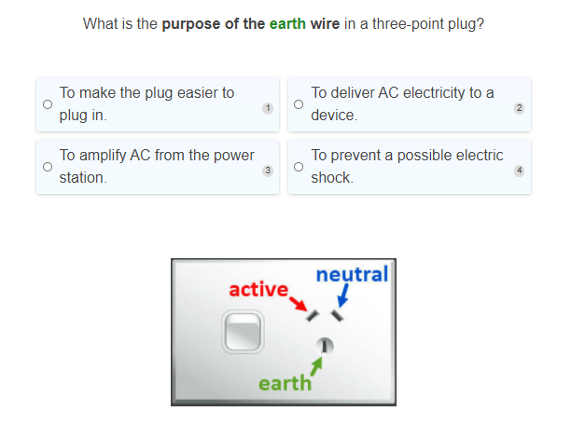

Slide 13
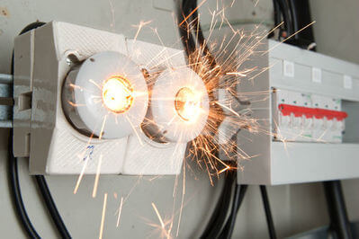
The system that distributes electrical power around your home is rather complicated. Sometimes things can go wrong, so it's important that we understand how to be safe around electricity.
A short circuit can happen when there is a direct (and unwanted) connection between the active and neutral wires of an appliance. This creates a very low-resistance path for current, which will bypass the appliance in question.
Not only does the appliance lose power, but the wires can get very hot and break down. This is because, with low resistance along the path, the current becomes very high. This would damage the appliance, or make it unusable!

Slide 14
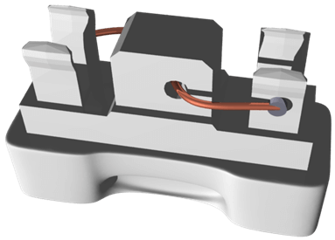
To stop a short circuit from doing too much damage, devices like fuses and circuit breakers are used.
Here is a model of a typical fuse. There is always a fuse connected to the active wire. It consists of a thin length of copper wire, held in a ceramic carrier. If the current through it becomes too high, the thin wire melts and breaks the circuit.
This prevents permanent damage to the appliance and saves money, since fuses are relatively cheap to replace. In general, fuses are rated at 15 A in lighting circuits, and at around 30 A for large appliances.
A circuit breaker does the same job, but in a different way. It contains a small electromagnet that opens a switch when the current becomes too high. When the switch opens, the circuit breaks. It can open in a very short amount of time, which saves the circuit from overheating and melting.

Slide 15

There are many other electronic devices designed to keep us safe, but the most important protection is common sense! Here are six straightforward rules to keep in mind when faced with an electrical issue.
1. | Do not try to repair an electrical appliance yourself, unless you are qualified.
2. | Never mix electricity and water.
3. | Replace all defective or damaged appliances and cords.
4. | Do not perform experiments on appliances that are switched on.
5. | Stay away from overhead power lines.
6. | Make sure you're up to date on your first aid skills.

Slide 16
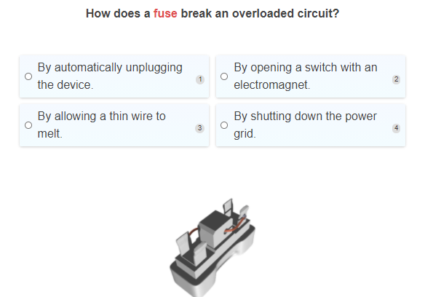

Slide 17
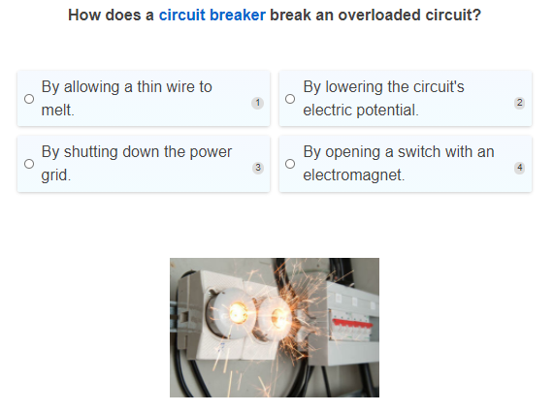

Slide 18
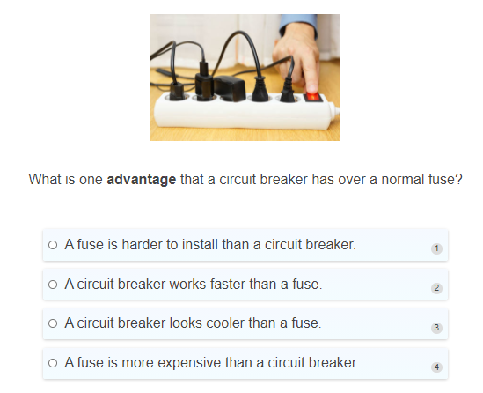

Slide 19
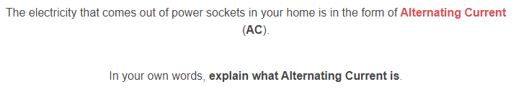

Slide 20
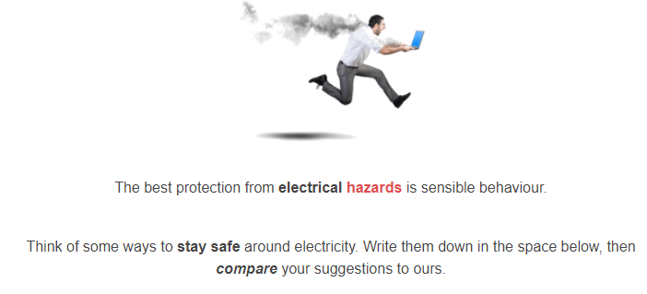

Slide 21


